Slide 1
MRTM0
MRTM
MRTM2
Nov 10, 2023
Zeyu Zhou
MIRA Group Meeting Review

Slide 2
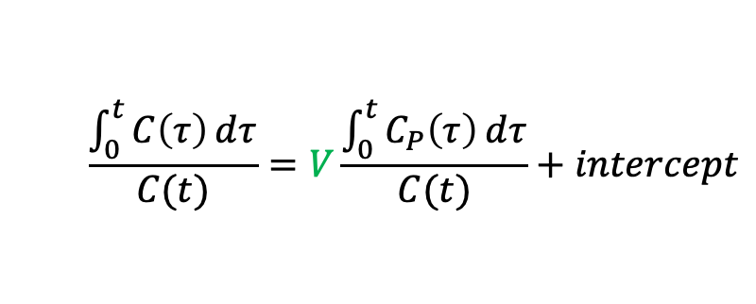

Review: Logan plot
Reversible binding/uptake
No assumption on any particular compartment model
$$\frac{\int_{0}^{t}{C\left(τ\right)ⅆτ}}{C(t)}=V\frac{\int_{0}^{t}{C_{P}\left(τ\right)ⅆτ}}{C(t)}+intercept$$
for $t>t^{∗}$
Total tissue distribution volume

Slide 3
















Review: Logan plot
Reversible binding/uptake
No assumption on any particular compartment model
$$\frac{\int_{0}^{t}{C\left(τ\right)ⅆτ}}{C(t)}=V\frac{\int_{0}^{t}{C_{P}\left(τ\right)ⅆτ}}{C(t)}+intercept$$
for $t>t^{∗}$
Total tissue distribution volume
$$C=C_{1}$$
$$K_{1}$$
$$V=\frac{K_{1}}{k_{2}}$$
$$intercept=−\frac{1}{k_{2}}$$
$$C_{P}$$
$$C_{1}$$
$$k_{2}$$
$$C=C_{1}+C_{2}$$
$$K_{1}$$
$$k_{3}$$
$$C_{P}$$
$$V=\frac{K_{1}}{k_{2}}\left(1+\frac{k_{3}}{k_{4}}\right)=\frac{K_{1}}{k_{2}}\left(1+BP\right)$$
$$C_{1}$$
$$C_{2}$$
$$k_{2}$$
$$k_{4}$$

Slide 4
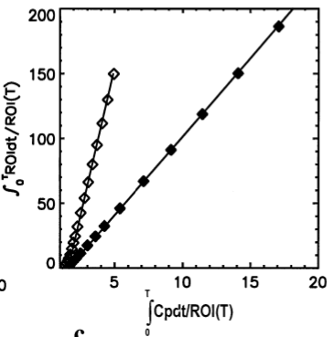
Review: Logan plot
Reversible binding/uptake
No assumption on any particular compartment model
$$\frac{\int_{0}^{t}{C\left(τ\right)ⅆτ}}{C(t)}=V\frac{\int_{0}^{t}{C_{P}\left(τ\right)ⅆτ}}{C(t)}+intercept$$
for $t>t^{∗}$
Total tissue distribution volume
Logan plot of simulated data with two different V’s
Figure source: Logan, Graphical Analysis of PET Data Applied to Reversible and Irreversible Tracers, 2000

Slide 5






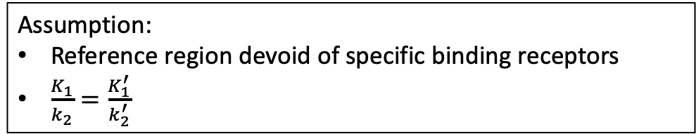




MRTM0
Assumption:
Reference region devoid of specific binding receptors
$\frac{K_{1}}{k_{2}}=\frac{K_{1}^{′}}{k_{2}^{′}}$
$$C=C_{1}+C_{2}$$
$$K_{1}$$
$$k_{3}$$
$$C_{1}$$
$$C_{2}$$
$$C_{P}$$
$$k_{2}$$
$$k_{4}$$
$$K_{1}^{′}$$
$$C_{}^{′}$$
$$k_{2}^{′}$$

Slide 6
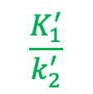
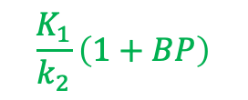
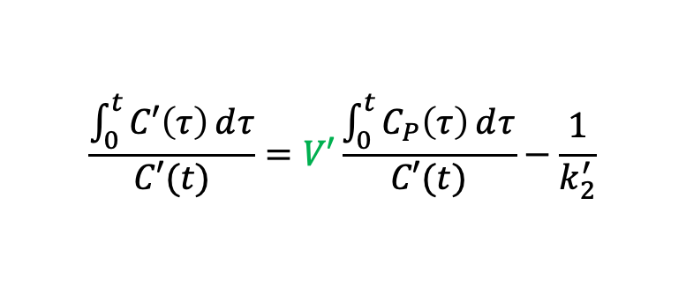
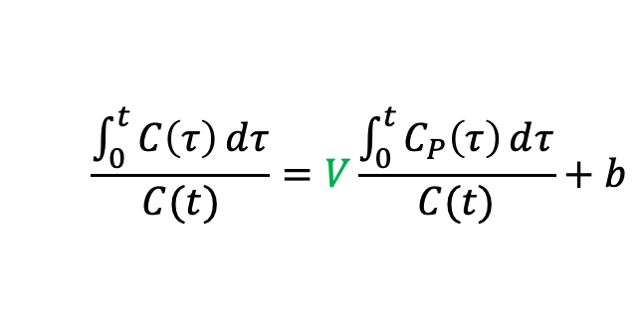
MRTM0
Assumption:
Reference region devoid of specific binding receptors
$\frac{K_{1}}{k_{2}}=\frac{K_{1}^{′}}{k_{2}^{′}}$
$$C=C_{1}+C_{2}$$
$$K_{1}$$
$$k_{3}$$
$$\frac{\int_{0}^{t}{C\left(τ\right)ⅆτ}}{C(t)}=V\frac{\int_{0}^{t}{C_{P}\left(τ\right)ⅆτ}}{C(t)}+b$$
$$C_{1}$$
$$C_{2}$$
$$k_{4}$$
$$\frac{K_{1}}{k_{2}}\left(1+BP\right)$$
$$C_{P}$$
$$k_{2}$$
$$K_{1}^{′}$$
$$C_{}^{′}$$
$$\frac{\int_{0}^{t}{C′\left(τ\right)ⅆτ}}{C′(t)}=V′\frac{\int_{0}^{t}{C_{P}\left(τ\right)ⅆτ}}{C′(t)}−\frac{1}{k_{2}^{′}}$$
$$k_{2}^{′}$$
$$\frac{K_{1}^{′}}{k_{2}^{′}}$$

Slide 7
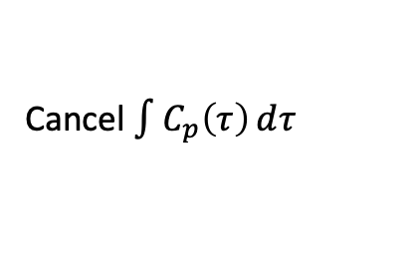




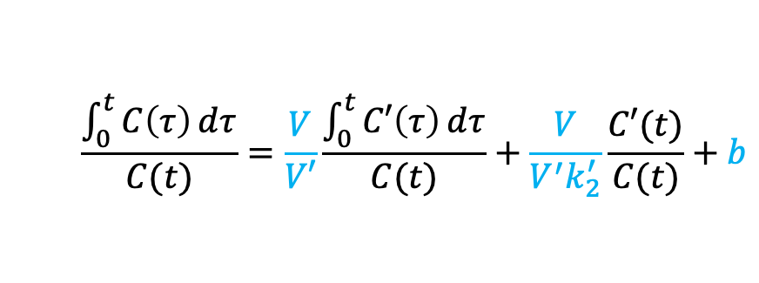
MRTM0
Assumption:
Reference region devoid of specific binding receptors
$\frac{K_{1}}{k_{2}}=\frac{K_{1}^{′}}{k_{2}^{′}}$
$$C=C_{1}+C_{2}$$
$$K_{1}$$
$$k_{3}$$
$$\frac{\int_{0}^{t}{C\left(τ\right)ⅆτ}}{C(t)}=V\frac{\int_{0}^{t}{C_{P}\left(τ\right)ⅆτ}}{C(t)}+b$$
$$C_{1}$$
$$C_{2}$$
$$k_{4}$$
$$\frac{K_{1}}{k_{2}}\left(1+BP\right)$$
$$C_{P}$$
$$k_{2}$$
$$K_{1}^{′}$$
$$C_{}^{′}$$
$$\frac{\int_{0}^{t}{C′\left(τ\right)ⅆτ}}{C′(t)}=V′\frac{\int_{0}^{t}{C_{P}\left(τ\right)ⅆτ}}{C′(t)}−\frac{1}{k_{2}^{′}}$$
$$k_{2}^{′}$$
$$\frac{K_{1}^{′}}{k_{2}^{′}}$$
Cancel $\int{C_{p}\left(τ\right)ⅆτ}$
$$\frac{\int_{0}^{t}{C\left(τ\right)ⅆτ}}{C(t)}=\frac{V}{V′}\frac{\int_{0}^{t}{C′\left(τ\right)ⅆτ}}{C(t)}+\frac{V}{V^{′}k_{2}^{′}}\frac{C′(t)}{C(t)}+b$$
$$BP=β_{1}−1$$
$$β_{1}$$
$$β_{2}$$
$$β_{3}$$
Multilinear regression

Slide 8


MRTM0
$$\frac{\int_{0}^{t}{C\left(τ\right)ⅆτ}}{C(t)}=\frac{V}{V′}\frac{\int_{0}^{t}{C′\left(τ\right)ⅆτ}}{C(t)}+\frac{V}{V^{′}k_{2}^{′}}\frac{C′(t)}{C(t)}+b$$
$$Z=β_{1}X +β_{2}Y +β_{3}$$
Major drawback: high bias

Slide 9
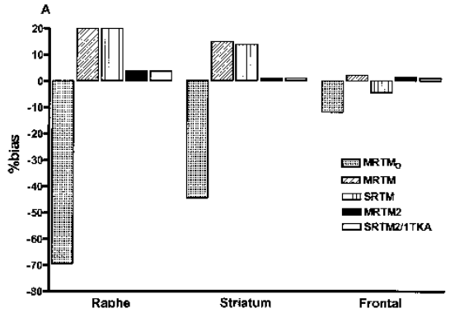
MRTM0
$$\frac{\int_{0}^{t}{C\left(τ\right)ⅆτ}}{C(t)}=\frac{V}{V′}\frac{\int_{0}^{t}{C′\left(τ\right)ⅆτ}}{C(t)}+\frac{V}{V^{′}k_{2}^{′}}\frac{C′(t)}{C(t)}+b$$
$$Z=β_{1}X +β_{2}Y +β_{3}$$
Major drawback: high bias
Estimates of bias for MRTM0 from simulated data at 15% noise
Figure source: Ichise et al., Linearized Reference Tissue Parametric Imaging Methods: Application to [11C]DASB PET Studies of the Serotonin Transporter in Human Brain, 2003

Slide 10
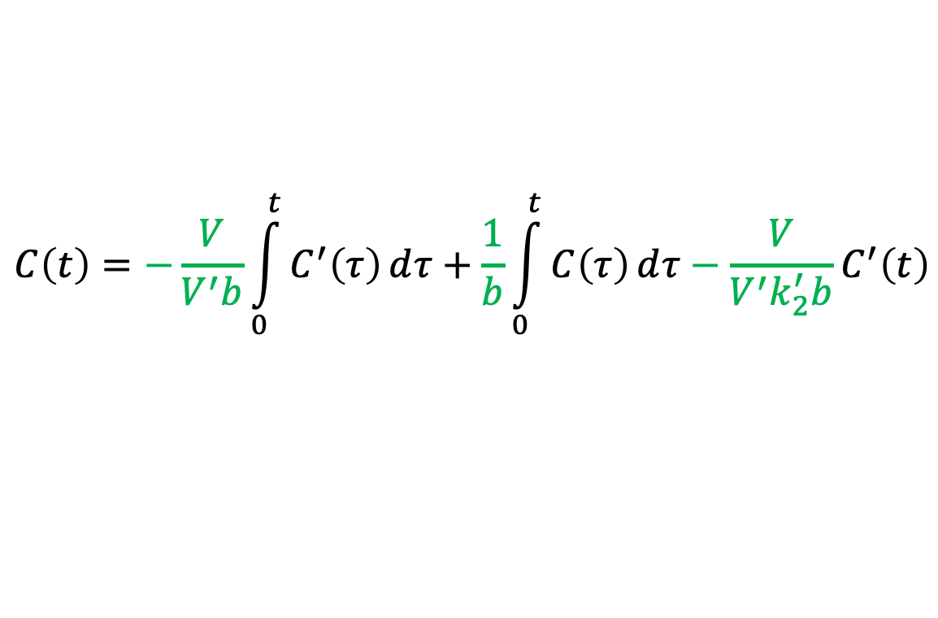
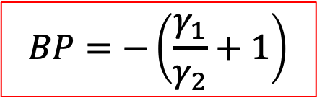




MRTM
$$\frac{\int_{0}^{t}{C\left(τ\right)ⅆτ}}{C(t)}=\frac{V}{V′}\frac{\int_{0}^{t}{C′\left(τ\right)ⅆτ}}{C(t)}+\frac{V}{V^{′}k_{2}^{′}}\frac{C′(t)}{C(t)}+b$$
Re-arrange
$$C\left(t\right)=−\frac{V}{V^{′}b}\int_{0}^{t}{C^{′}\left(τ\right)ⅆτ}+\frac{1}{b}\int_{0}^{t}{C\left(τ\right)ⅆτ}−\frac{V}{V^{′}k_{2}^{′}b}C^{′}\left(t\right)$$
$$γ_{1}$$
$$γ_{2}$$
$$γ_{3}$$
$$BP=−\left(\frac{γ_{1}}{γ_{2}}+1\right)$$
Benefit: reduced bias
Problem: high variability

Slide 11
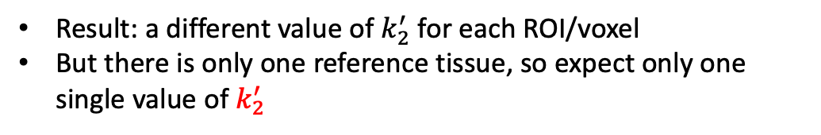

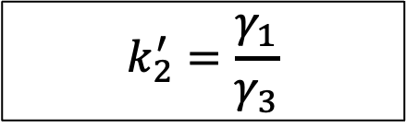

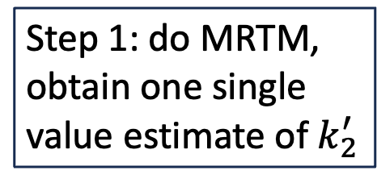


MRTM2
$$C\left(t\right)=−\frac{V}{V^{′}b}\int_{0}^{t}{C^{′}\left(τ\right)ⅆτ}+\frac{1}{b}\int_{0}^{t}{C\left(τ\right)ⅆτ}−\frac{V}{V^{′}k_{2}^{′}b}C^{′}\left(t\right)$$
Step 1: do MRTM, obtain one single value estimate of $k_{2}^{′}$
$$γ_{1}$$
$$γ_{2}$$
$$γ_{3}$$
$$k_{2}^{′}=\frac{γ_{1}}{γ_{3}}$$
Result: a different value of $k_{2}^{′}$ for each ROI/voxel
But there is only one reference tissue, so expect only one single value of $k_{2}^{′}$

Slide 12
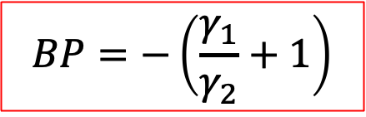


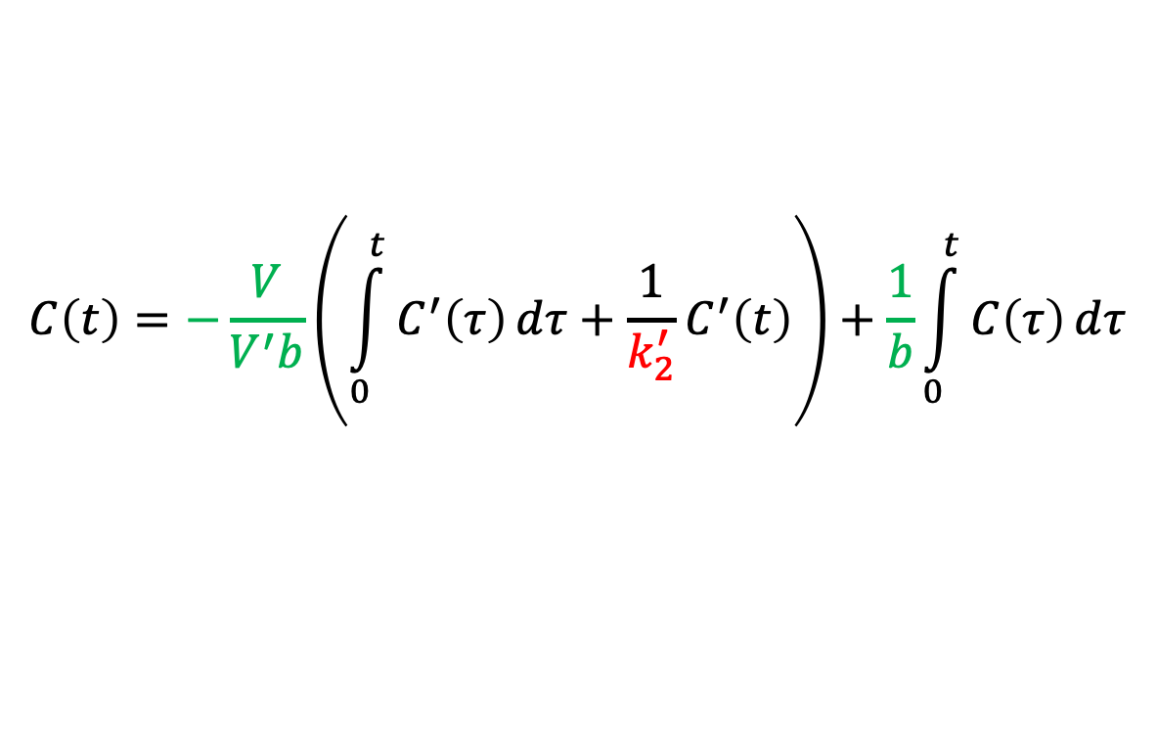
MRTM2
$$C\left(t\right)=−\frac{V}{V^{′}b}\int_{0}^{t}{C^{′}\left(τ\right)ⅆτ}+\frac{1}{b}\int_{0}^{t}{C\left(τ\right)ⅆτ}−\frac{V}{V^{′}k_{2}^{′}b}C^{′}\left(t\right)$$
Step 1: do MRTM, obtain one single value estimate of $k_{2}^{′}$
$$γ_{1}$$
$$γ_{2}$$
$$γ_{3}$$
$$k_{2}^{′}=\frac{γ_{1}}{γ_{3}}$$
Result: a different value of $k_{2}^{′}$ for each ROI/voxel
But there is only one reference tissue, so expect only one single value of $k_{2}^{′}$
$$C\left(t\right)=−\frac{V}{V^{′}b}\left(\int_{0}^{t}{C^{′}\left(τ\right)ⅆτ}+\frac{1}{k_{2}^{′}}C^{′}\left(t\right)\right)+\frac{1}{b}\int_{0}^{t}{C\left(τ\right)ⅆτ}$$
Step 2: do MLR again, with only two parameters to estimate now
$$γ_{1}$$
$$γ_{2}$$
$$BP=−\left(\frac{γ_{1}}{γ_{2}}+1\right)$$
Reduced variability compared to MRTM

